Slide 1
Springboard Training Project: Emerging Technologies
Team 4
Senthil Kumar
Dadi Swamy Vinay
Sourjya Pal

Slide 2
Route to modelling
Preparation
EDA
Outlier Treatment
Feature and Model Selection

Slide 3
PROBLEM
MARKET CAPITAL
98 BILLION $
CUSTOMERS
People
manufacturers
Vendor A, B, D, E, F, G, H, Private-Label, Others
Growth patterns of Themes and its positioning of Vendor_A

Slide 4
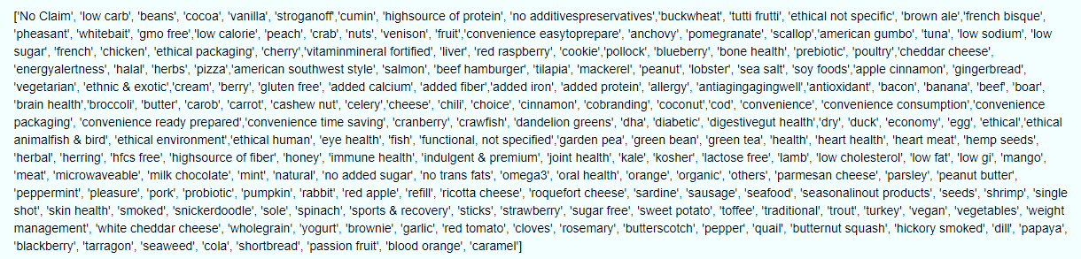
1.Data preparation
1.1 Unique Themes:

Slide 5
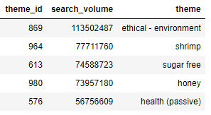
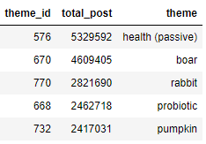
1.2 Popular themes across Datasets:
Search
SOCIAL

Slide 6
1.3 Data sufficiency, sparsity and anomaly
Social Media
Search Platforms
Product Manufacturer
Theme Product List
Theme List
Sales
1.4 Time Granularity
As the Sales Dataset is of Weekly update, Yearly Week-wise analysis is opted

Slide 7
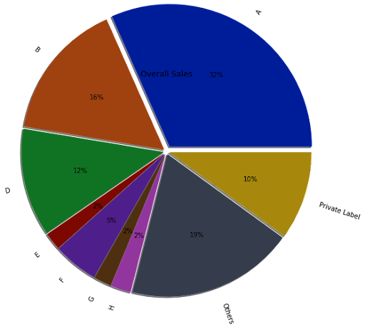
2. Data exploration
2.1 overall market share of our client
The market share of Vendor A is 32% which is 31.36bn $.

Slide 8
2.2 Potential competitors for our client in each theme:
Theme | Vendors
No Claim | B | D | E | F | G | H | Others | Private Label
pollock | B | D | F | H | Others | Private Label
pizza | B | D | F | H | Others | Private Label
cookie | B | D | F | H | Others | Private Label
soy foods | B | D | F | H | Others | Private Label
apple cinnamon | B | D | F | H | Others | Private Label
blueberry | B | D | F | H | Others | Private Label
american southwest style | B | D | F | H | Others | Private Label
salmon | B | D | F | H | Others | Private Label
ethnic & exotic | B | D | F | H | Others | Private Label
no additives/preservatives | B | D | F | H | Others | Private Label
low carb | B | D | F | H | Others | Private Label
chicken | B | D | F | H | Others | Private Label
buckwheat | B | D | F | H | Others | Private Label
gmo free | B | F | H | Others | Private Label
french bisque | B | D | F | Others | Private Label
american gumbo | B | F | H | Others | Private Label
stroganoff | B | D | F | H | Others
gingerbread | B | D | F | H | Others
low sugar | B | H | Others | Private Label
brown ale | B | H | Others | Private Label
low sodium | B | F | Others | Private Label
vegetarian | B | H | Others
ethical - packaging | B | F | Others
crab | F | Others | Private Label
beans | D | Others | Private Label
high/source of protein | B | Others
poultry | B | Others
tilapia | Others
beef hamburger | Others
tuna

Slide 9
2.3 Emerging themes
Search Platforms
Anti-aging/Aging-well
Oral health
Salmon
Bone health
Social Media
Sea salt
Sales
Ethical - not specific
Halal

Slide 10
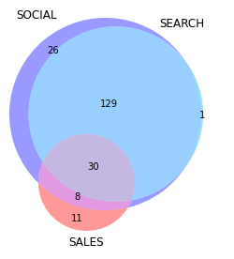
2.4 Trend flows from Social -> Search -> Sales
'beef hamburger', 'blueberry', 'bone health', 'chicken',
'convenience - easy-to-prepare', 'crab’, 'energy/alertness',
'ethical - not specific', 'ethical - packaging’, 'halal',
'ethnic & exotic', 'french bisque', 'gingerbread', 'gmo free', 'high/source of protein', 'low calorie', 'low carb', 'low sodium', 'low sugar', 'mackerel’, 'nuts', 'peach', 'poultry',
‘no additives/preservatives', 'prebiotic', 'salmon', 'sea salt', 'soy foods', 'tuna', 'vegetarian
193 → 129 → 30

Slide 11
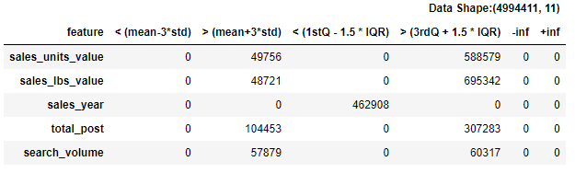
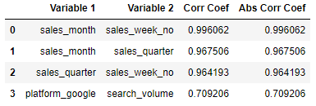
3.1 Model experimenting
Outlier Treatment
Percentile on Sales Units, Sales lbs , Search Volume and Total Post
Encoding
Target Encoding on Theme
One Hot Encoding on Vendors and Platforms
Correlation Effects
Sales_month, Sales_quarter, Platform_google are removed

Slide 12
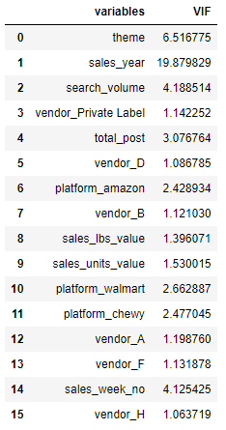
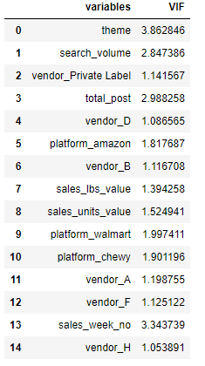
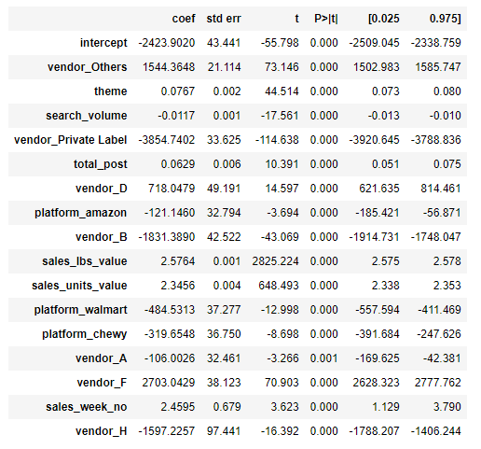
VIF Analysis (Linear Regression)

Slide 13
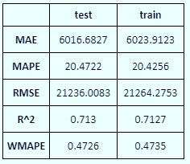
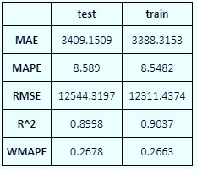
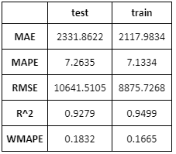
4. Model performance
ols model
Random forest
Xgboost
Linear Regression , XGBoost , RandomForest , Regression Comparison

Slide 14
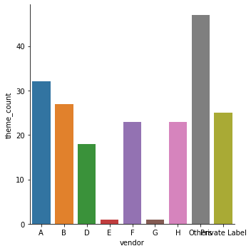
5. high business opportunity (901 Mn $)
Theme | Revenue | Vendors
cumin | $73,89,84,415.00 | Others
ethical - not specific | $4,90,07,009.00 | Others
sea salt | $4,70,05,459.00 | Others
mackerel | $1,68,86,910.00 | Others
halal | $1,47,01,854.00 | Others
cherrry | $1,09,48,767.00 | Others
bone health | $81,08,027.00 | Others
peach | $54,17,871.00 | Others
red raspberry | $52,94,008.00 | B,Private Label
peanut | $17,31,056.00 | Others
energy/alertness | $13,92,018.00 | H,Private Label,Others
prebiotic | $5,98,513.00 | Others
convenience - easy-to-prepare | $5,67,388.00 | Others
nuts | $2,17,048.00 | Private Label,Others
scallop | $1,38,672.00 | Others
low calorie | $59,181.00 | Others

